Slide 1
Developments to established dose-finding methodologies for application in trials with complex and innovative designs
Amit Patel
Supervisors: Prof. Lucinda Billingham, Dr. Kristian Brock

Slide 2
Aims
Investigate existing methodologies
Adapting current methodology
Explore the application of these ideas
Notes:
So, early-phase clinical trials typically revolve around trying to find a specific dose of a drug which can then be taken forward into later phase clinical trials. The methodology to do this in the past usually revolves around algorithm based designs. These follow a specific set of rules in order to find a dose. More recently, over the past 10 years or so model-based designs have become more popular. These designs work by determining the relationship between dose and toxicity and allocate patients based on modelling observed data. Model based designs have a lot of upsides in terms of efficiency and efficacy but they are much more difficult to implement compared to simple algorithm based designs.
This project aims to look in detail at these mode-based designs. We want to investigate existing methodologies and see how they can be used. We also want to adapt the current methodology for uses in what could be more complicated scenarios. This work is then all done with the idea that it could be implemented into actual trial designs that are run at the trials unit.

Slide 3
ADePT-DDR
Patient Population:
Patients with head and neck squamous cell carcinoma (HNSCC)
Intervention:
AZD6738
Radiotherapy dose 70Gy, delivered in 35F over 7 weeks
Objectives / Outcomes:
To evaluate the safety of AZD6738 in combination with Radiotherapy
Determine the recommended dose based on DLTs
Methodology:
Partial ordering time-to-event continual reassessment method
PO-TITE-CRM
Notes:
I’ll talk about my first chapter, which I believe I include a snippet of in my report. So this revolves around a trial we are currently running at the unit called ADePT-DDR. I won’t talk about the trial in detail more about what work I’ve done so far on it. There are just some details of the trial on screen right now.
It’s an early phase trial which due to issues with the doses selected for investigation and the type of intervention that was being used a novel methodology had to be implemented. This methodology was introduced back in 2013 and we believe that this trial is the first real world implementation of this design.
Part of my work in this chapter was to introduce the background to the trial as well as the issues which arose that led to the use of this methodology. A large part of my work then went into explaining the mathematics behind the design

Slide 4


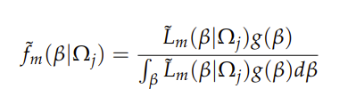
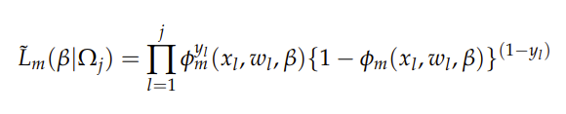

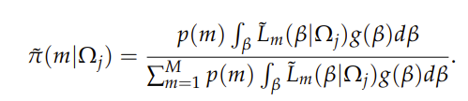
Notes:
Don’t worry I’m not going to explain all of these. Its just some examples of what I had to do. The original methodology was presented across two papers and as part of my work I had to combine all that into one coherent piece so it made sense. I then had to take all of this and produce code so we could actually run the design and see how the design works through simulations and operating characteristics.

Slide 5
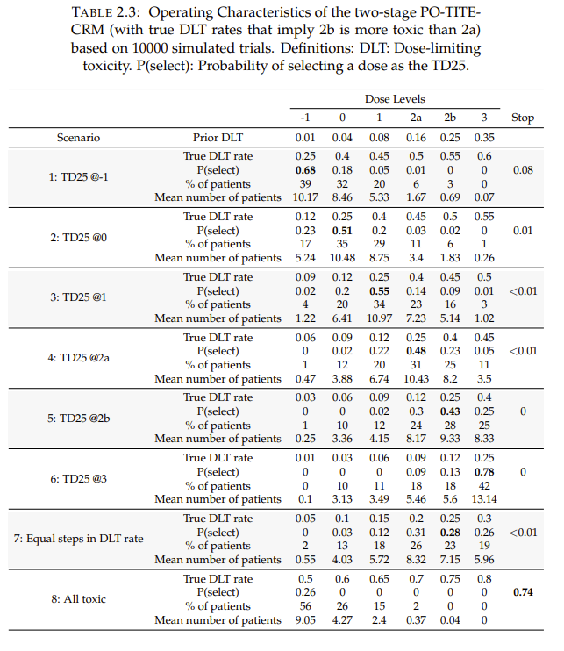
Notes:
I go on to detail the final design we chose for the trial. As well as the simulations and operating characteristics for that design specification. This involved a lot of iterative simulation work. We present 16 different scenarios and show various statistics for each dose-level.

Slide 6
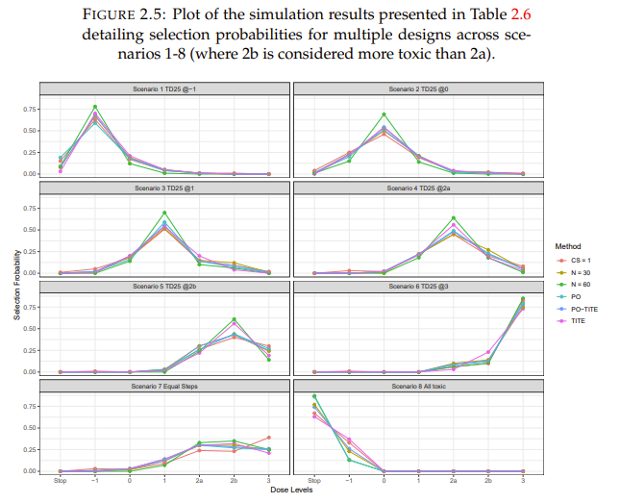
Notes:
To investigate our approach further we detail 5 alternative designs and compare how they all perform for the same set of scenarios. We showed that performance was similar across all the designs and that by using these alternative approaches we would be making assumptions about the treatment which weren’t clinically valid. So the use of this novel methodology is justifiable in the sense that for this complex problem we can maintain a similar level of efficiency without making invalid clinical claims.

Slide 7
ADEPT-DDR Summary
Mathematics of the design
Experiences implementing the design
Extensive simulation work

Slide 8
RtC Wages and Tait
Aim:
To obtain the optimal biological dose (OBD)
Uses both efficacy and toxicity outcomes
Models toxicity and efficacy
Notes:
My next chapter revolves around an extension we developed for an seamless adaptive phase I/II trial design. Whereas before we were just concerned about toxicity. This design also focuses on efficacy and trys to find a dose which is optimal ie the most efficacious and the least toxic.

Slide 9
Adding a Control Arm
Rationale
Adaptive designs don’t replace the need for randomised Phase II trial
Example:
Investigation of a standard of care treatment in combination with an experimental treatment
Notes:
I mentionded that the wages and tait design is a seamless adaptive phase I/II design. These designs ultimately aim to replace the need of conducting phase I and Phase II trials independently. However, a lot of the methodology currently only focuses on using efficacy to determine the OBD. Once this is done there may still be a need to collect more data on efficacy in a randomized phase II setting depending on treatment. So, whist useful these designs don’t replace the need for a randomized phase II trial.
Due to components in the wages and tait design we hope to modify that to allow us to recruit patients to a control dose. This will also allow us to make inferences on the efficacy of treatment compared directly to a control dose.
One example where this could be used is when investigating a standard of care dose with a known toxicity and efficacy profile in combination with an experimental treatment. The first dose-level would be the standard of care then subsequent dose levels would be more of the experimental treatment and we’d be able to determine how efficacy and toxicity increase/decrease with the doses of experimental treatment.

Slide 10
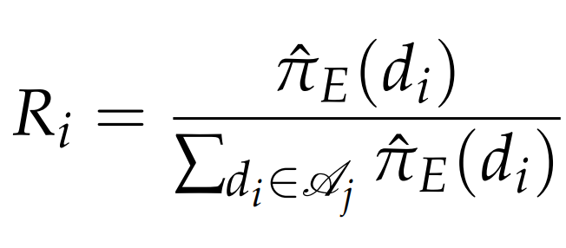
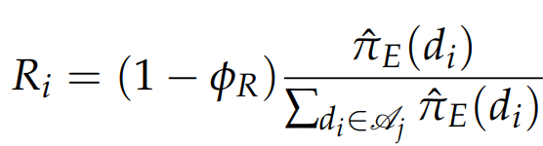

Application
Standard Wages and Tait
RtC-WT
Notes:
More math but a bit simpler this time. As this design is already established I detail the maths behind it in the chapter. As well as the change needed to make our modification

Slide 11
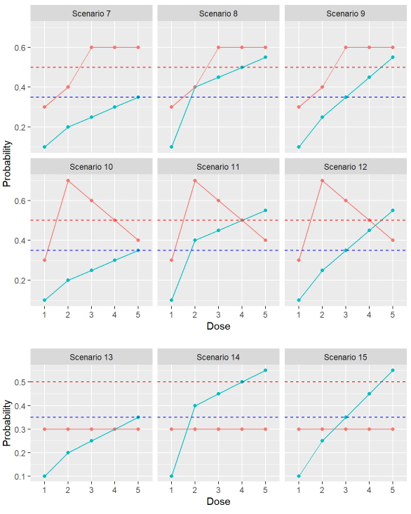
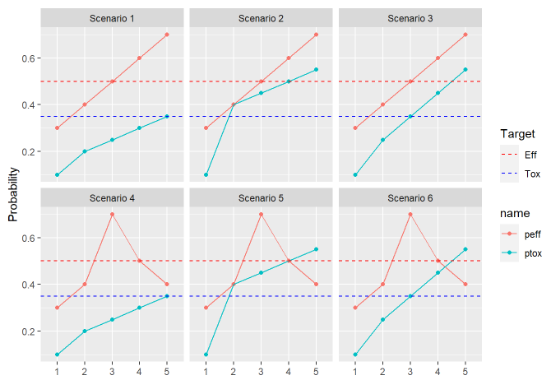
Simulations - Scenarios
Notes:
In order to assess the design, we ran simulations across 15 different scenarios. Looking at different potential efficacy and toxicity curves. In our examples here we have 5 dose-levels with the first dose-level being the control dose. We have a target toxicity rate of 35 % and efficacy rate of 50%. So we’re looking for a dose which has at least 50% efficacy rate with no mare than a 35% toxicity rate. In all these scenarios the control dose, dose-level 1 has 10% toxicity rate and 30% efficacy rate.

Slide 12
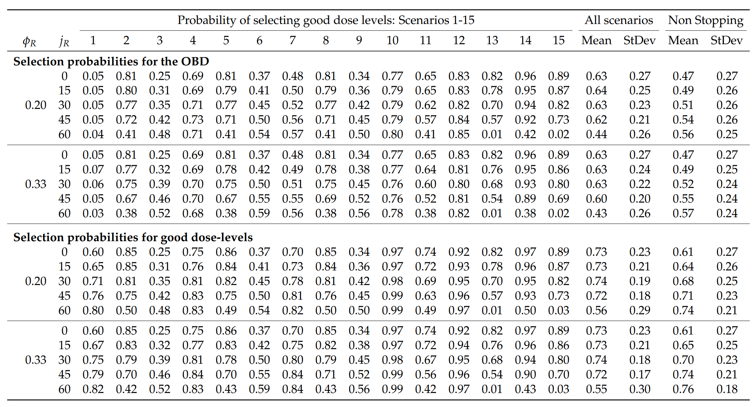
Simulation - Results
Notes:
We simulated 10000 trials for each scenario. In each trial we had those 5 dose-levels and were aiming to recruit 60 patients. We included stopping rules to stop if the lowest experimental dose was too toxic.

Slide 13
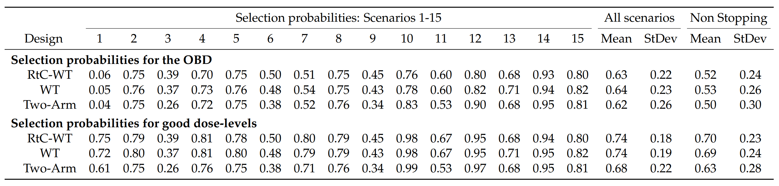
Alternative Designs – Simulation Results
Notes:
We then look at two alternative-designs which could be implemented and again we run the same scenarios too see how the designs perform and they are fairly similar overall.

Slide 14
RtC Wages and Tait
RtC-WT maintains reasonable operating characteristics when randomising patients to a control dose
We investigated a variety of parametrisations
We made comparisons to alternative designs
Further work: - Investigate the power this design would have in comparison to a randomized phase II trial

Slide 15
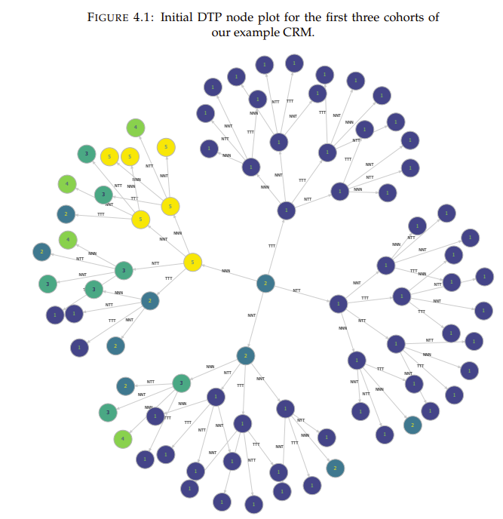
TITE - DTPs
Notes:
This is our third chapter which is still under development and it revolves around dose transition pathways. Dose transition pathways are an effective way to communicate the complexities of model-based dose-finding trials with non statisticians. This is a visualization of a DTP. Our aim in this chapter is to extend this to time-to event methodology. So, time-to-event methods are an extension to model based designs which allow you to model toxicity based on the time at which it does/doesn’t occur. This adds an additional layer of complexity to normal DTPs. Normal DTPs function based on wether or not a patient experiences a toxicity or not as a yes no variable. Time to event DTPS also include the time which is a continuous variable and can take a number of values in a given range.
Show example
No one has really explored TITE DTPs before so we will write about our approach and its general infeasibility and look at potential alternatives.

Slide 16
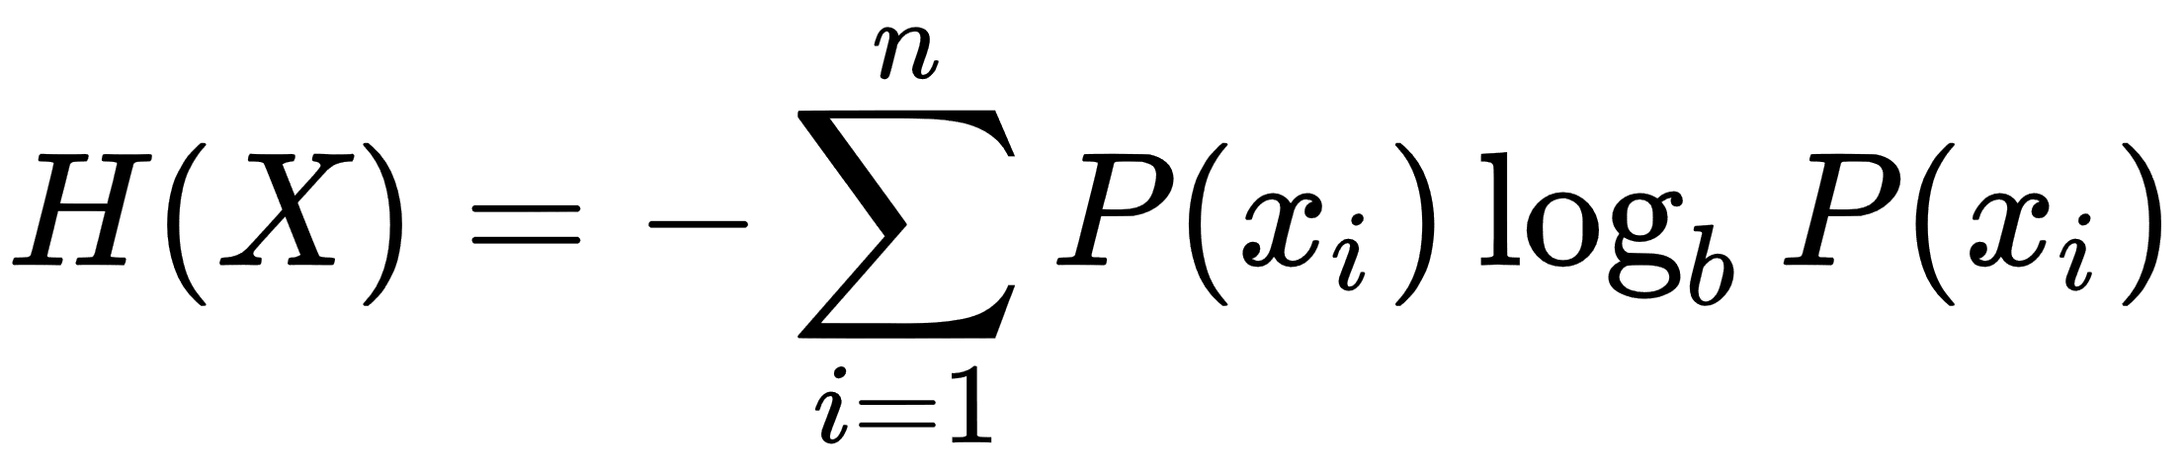
Further work
Shannon Entropy:

